Slide 1


LGBoost Regressor
Jayashree M

Slide 2
What is LG Boosting Regressor?
LG Boosting (Light Gradient Boosting) Regressor
A fast and efficient machine learning algorithm
Used to predict numerical values
Based on decision trees
Designed to handle large datasets quickly
Known as part of the LightGBM framework

Slide 3
Why is LG Boosting Fast?
Uses Leaf-wise tree growth (grows deeper where needed)
Skips unnecessary data scans
Efficient with large datasets
Supports parallel training
Uses low memory
Works better than many boosting algorithms when data is big

Slide 4
How LG Boosting Works
Start with a simple prediction (baseline)
Build a tree to correct errors
Add more trees — each focuses on the remaining mistakes
Grows leaf nodes where improvement is highest
Final prediction = combination of all small trees
Easy idea: It focuses more on the “problem areas,” improving accuracy faster.

Slide 5
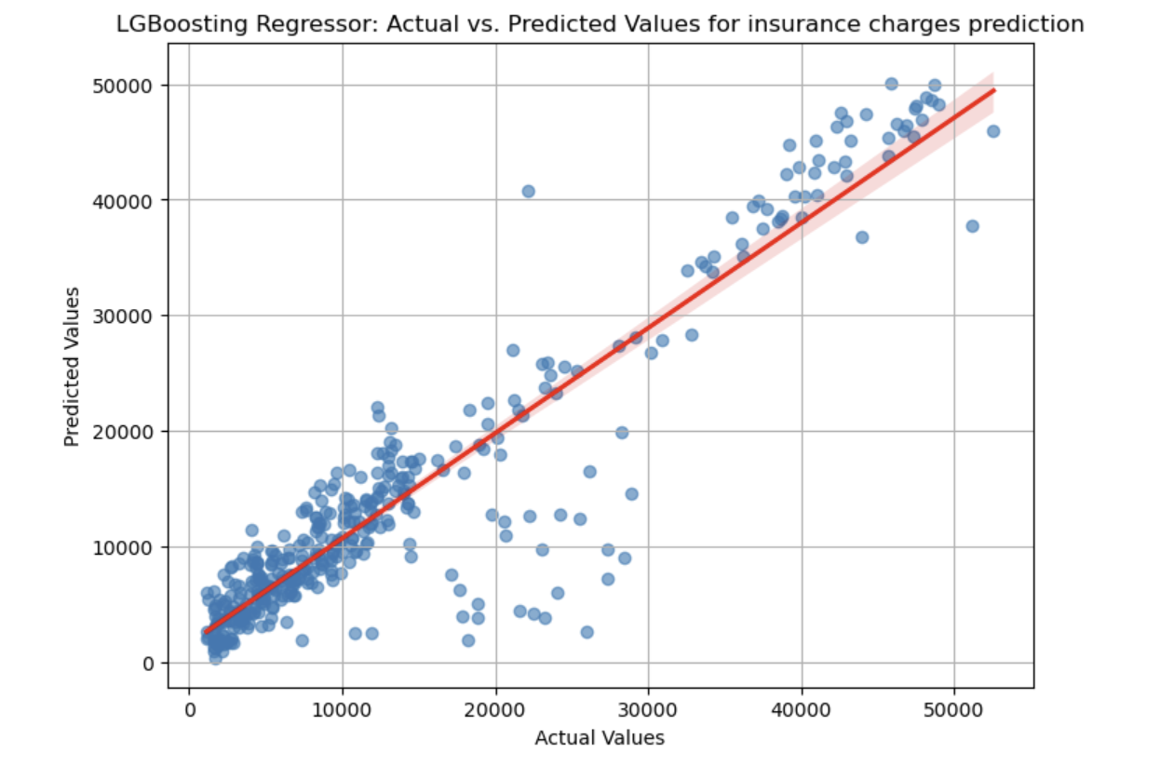
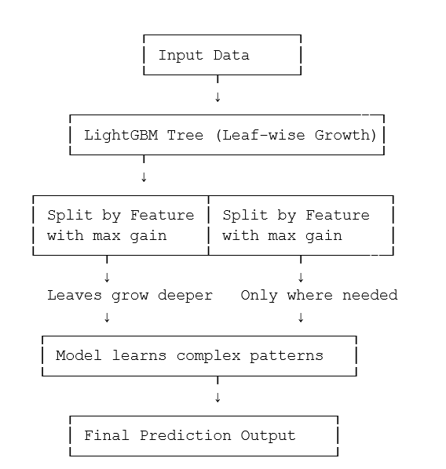
Example : Insurance charges Prediction

